Slide 1

By Rishabh Chaudhary
Business Analyst Career Program - Internship Project

Slide 2

Agenda
Import the Data into PowerBI
Explaining insights from the Plot/Graph Plotted.
Interactive Dashboard by using visualization tools
Conclusion and Inferences
Endnotes

Slide 3
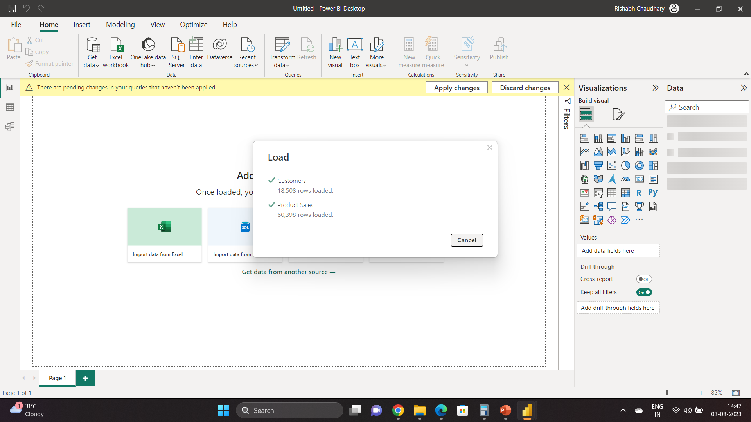
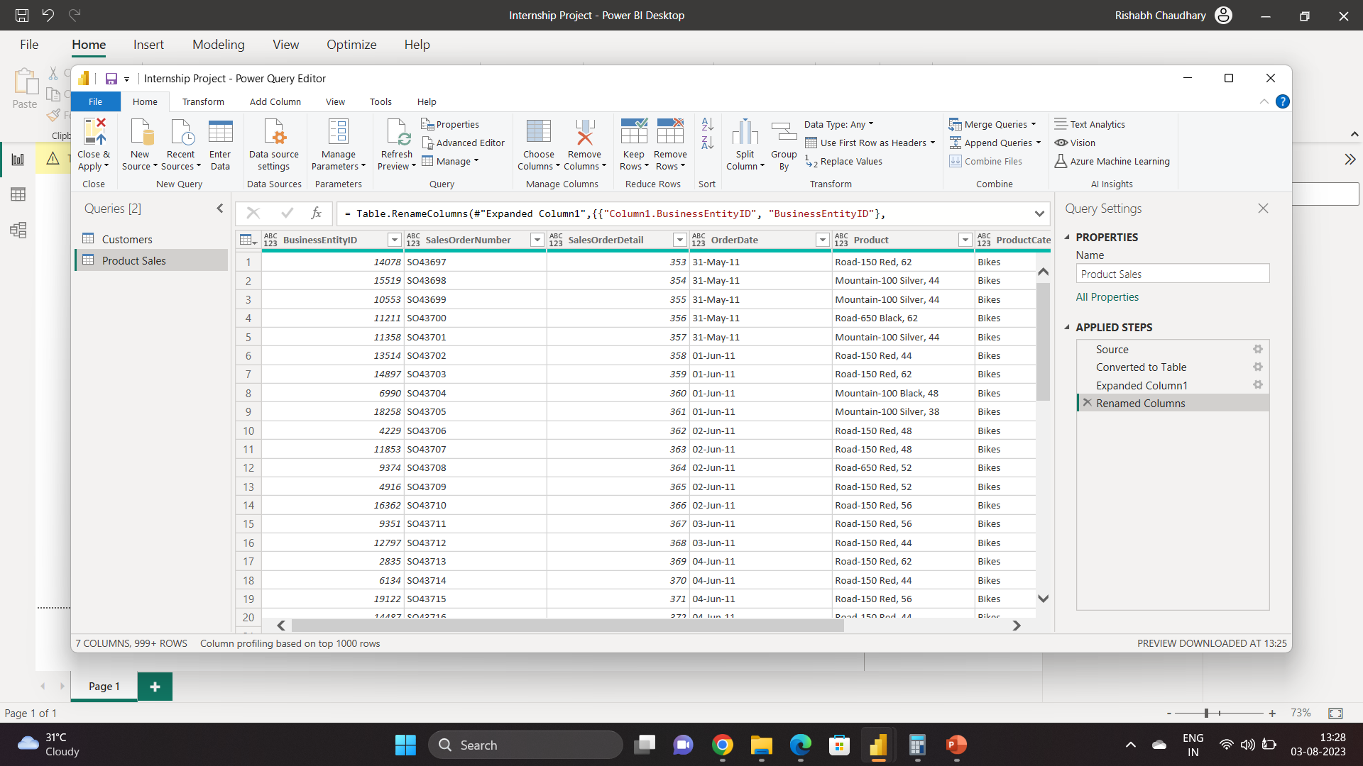
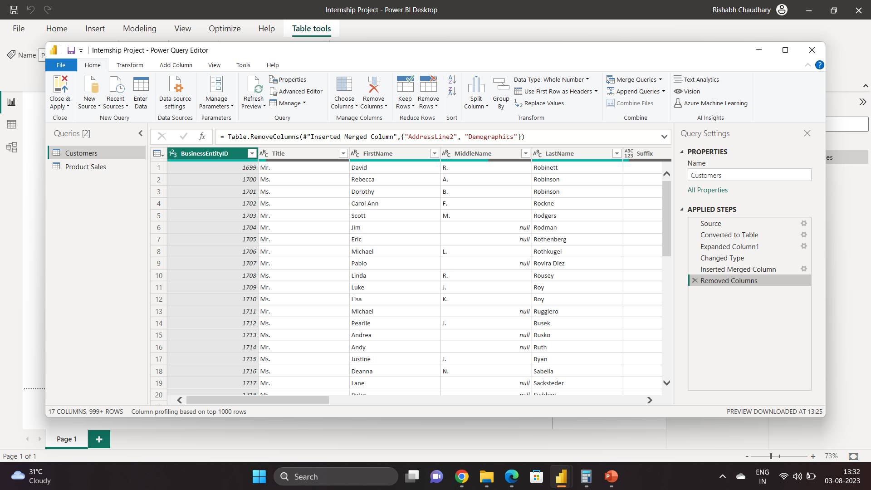
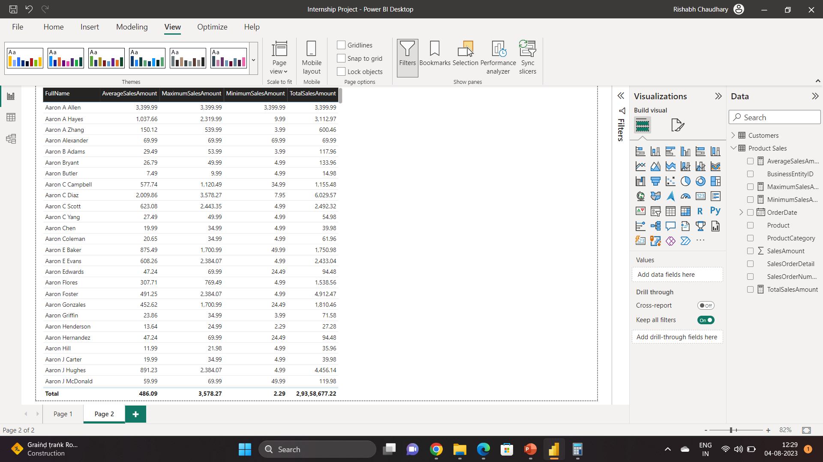
Import the Data into PowerBI

Slide 4
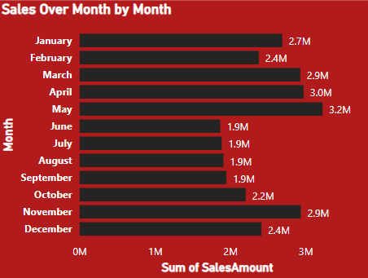
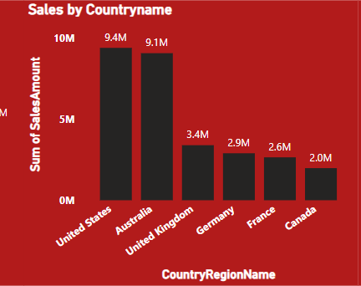
Insights from the Plot/Graph Plotted.
Clustered Bar Chart: A clustered bar chart be used to display the sales amounts for each month. It will make it easy to compare sales across different months and identify which months had higher or lower sales. The bar graph is especially useful when you want to emphasize the differences between individual months.
A clustered column chart would be a great choice for visualizing the sales amounts for different countries or regions. This type of chart displays the data in vertical columns side by side, allowing for easy comparison between the sales amounts of each region.
Insights from the data:
1-Sales tend to be higher during the first half of the year (January to June), with a peak in May. This indicates a potential seasonal pattern where sales are stronger in the early part of the year.
2-Sales start to decrease in the second half of the year (July to December), with a noticeable drop in June. This could be an area of concern for further analysis to understand the reason for the decline.
3-The highest sales amount was recorded in May, while the lowest was in June, suggesting a significant month-to-month variation.
Insights from the data:
1-The United States and Australia have the highest sales amounts, indicating that these are the top-performing regions in terms of sales revenue.
2-The United Kingdom, Germany, and France follow, with reasonably high sales amounts but lower than the United States and Australia.
3-Canada has the lowest sales amount among the listed regions.

Slide 5
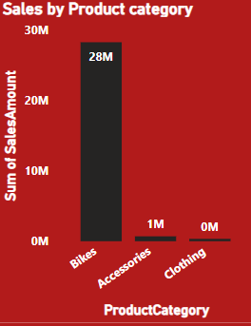
Insights from the Plot/Graph Plotted.
1-Bikes Category Dominates Sales: The "Bikes" category is the clear frontrunner in terms of sales performance, with a sum of sales amount of 28,318,144.65. This indicates that the sale of bikes is a major revenue generator for the company or business.
2-Accessories and Clothing have Lower Sales: Compared to the "Bikes" category, both "Accessories" and "Clothing" categories have significantly lower sales amounts. "Accessories" generated 700,759.96 in sales, while "Clothing" brought in 339,772.61. This suggests that these categories might be less popular or might have a lower price point than bikes.
3-Opportunities for Growth in Accessories and Clothing: While "Bikes" dominate sales, there could be opportunities for growth in the "Accessories" and "Clothing" categories. Businesses might consider implementing marketing strategies or introducing new and trendy accessories or clothing products to boost sales in these categories.
4-Diversification of Product Portfolio: The data shows that the business is not solely reliant on one product category. Having multiple product categories (Bikes, Accessories, and Clothing) can help spread risks and reduce dependency on a single category.
5-Seasonal Trends: Further analysis would be required to identify if there are any seasonal trends or fluctuations in sales across the different product categories. Understanding such patterns can help in optimizing inventory management and marketing efforts.
6-Pricing and Margins: Analyzing the sales performance in conjunction with the profit margins for each product category can provide insights into the overall profitability of the business. It might be essential to ensure that even though "Bikes" have higher sales, their production costs and margins are also favorable.

Slide 6
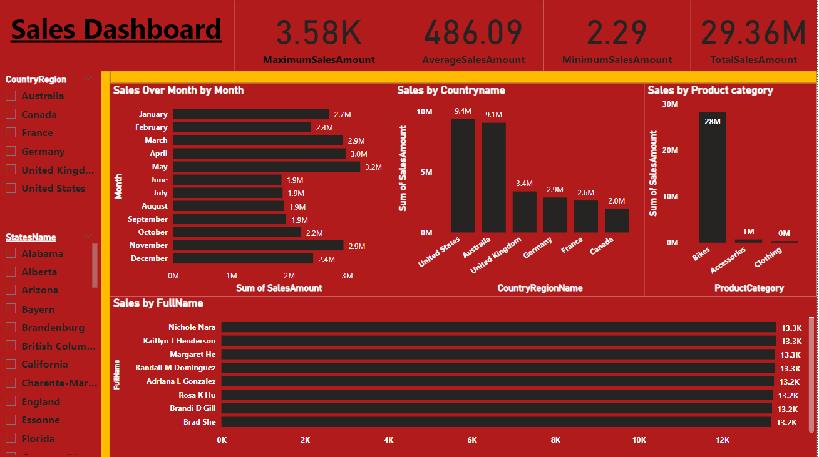
Interactive Dashboard by using visualization tools
The dashboard typically includes information on total sales amounts, sales by region, product category breakdowns, top-selling products, customer segmentation, and sales forecasting. Users can interact with the dashboard, drill down into specific data points, and explore sales data at various levels of granularity to make informed decisions and optimize their sales strategies. Overall, the Sales Dashboard from Power BI helps businesses monitor and analyze their sales performance efficiently and aids in driving growth and profitability. The dashboard typically includes information on total sales amounts, sales by region, product category breakdowns, top-selling products, customer segmentation, and sales forecasting. Users can interact with the dashboard, drill down into specific data points, and explore sales data at various levels of granularity to make informed decisions and optimize their sales strategies. Overall, the Sales Dashboard from Power BI helps businesses monitor and analyze their sales performance efficiently and aids in driving growth and profitability.

Slide 7
Conclusion and Inferences
Monthly Sales Trend:
The sales amount shows fluctuations throughout the year, with some months having higher sales than others. The highest sales were recorded in May, with $3,224,786.807, while the lowest sales were in June, with $1,866,221.438.
There is a noticeable increase in sales during the last few months of the year (October to December), which might be due to holiday season shopping.
Sales by Country/Region:
The United States and Australia are the top two countries in terms of sales, with $9,389,789.511 and $9,061,000.584, respectively. These two countries contribute significantly to the total sales amount.
The United Kingdom, Germany, France, and Canada also have substantial sales figures, although they are lower than the United States and Australia.

Slide 8
Conclusion and Inferences
Sales by Product Category:
Bikes are the highest-selling product category, accounting for a significant portion of the total sales with $28,318,144.65.
Accessories and Clothing have much lower sales compared to Bikes, with sales amounts of $700,759.96 and $339,772.61, respectively.
Seasonal Sales Pattern:
The data suggests that there might be a seasonal sales pattern, with higher sales during specific months (e.g., May) and lower sales during others (e.g., June).
This could be related to factors like weather, holidays, or specific marketing and promotional activities during certain periods.
Market Dominance:
The United States and Australia seem to be the dominant markets for the company, contributing significantly to the overall sales. Understanding the factors that make these countries successful can help in strategizing for other markets.

Slide 9
Conclusion and Inferences
Focus on Bikes:
The company should focus on leveraging the popularity of Bikes and invest in marketing, product development, and customer engagement to maintain and potentially increase sales in this category.
Diversification:
Although Bikes are the top-selling category, there is room for growth in Accessories and Clothing. The company can explore strategies to boost sales in these categories and diversify its revenue streams.
Targeting High-Performing Regions:
The United States and Australia, being the highest-selling regions, could be prioritized for additional marketing efforts and resources to sustain and expand their performance.
Addressing Low-Performing Months:
June and July seem to be the months with the lowest sales. Understanding the reasons behind this trend and implementing targeted campaigns or promotions during these months could help in boosting sales during the off-peak period.
Overall, a careful analysis of the sales data can help the company make informed business decisions, optimize marketing strategies, and identify opportunities for growth and improvement in both high-performing and low-performing segments of the market

Slide 10
Endnotes
Reference Links:-
Internship Project.pbix

